Slide 1
Road Safety Scenario India-Karnataka

Slide 2
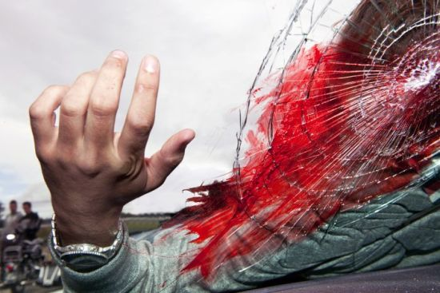
India at glance
Deaths in a year
141526 (as per NCRB 2014)
207551 (as per WHO 2015)
nearly 387 people die daily
nearly 20 children die daily
One death every 2.5 minutes

Slide 3
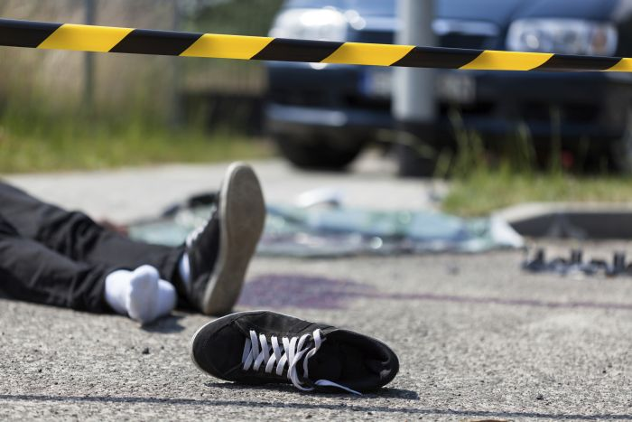
Crashes
Deaths

Slide 4
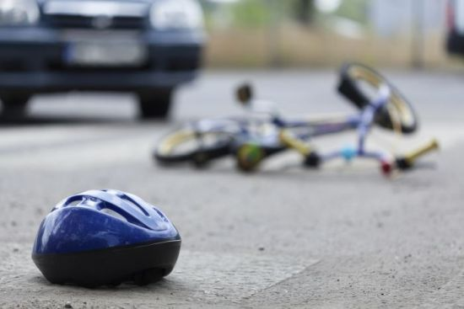
Crashes
Deaths
Notes:
2 deaths every day in Bengaluru

Slide 5
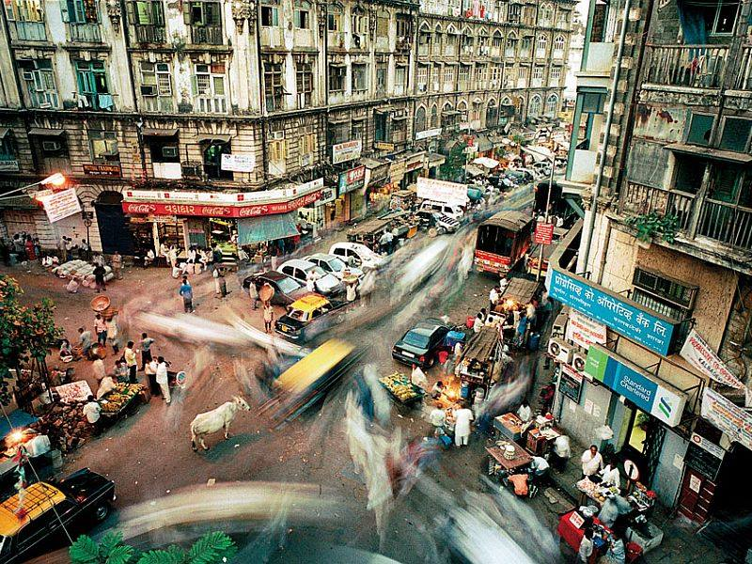
Road Deaths in Karnataka
Notes:
Nearly 30 deaths in a day (28.5)
One death every 50 minutes – in less than an hour
56196 got injured in 2015

Slide 6
Positive Measures
Notification of Karnataka State Road Safety Policy
Mukhyamantri Santwana Harish Scheme
Budget provision for more trauma centers
Mandating helmets for all riders (two-wheelers)
Support for national legislation on road safety

Slide 7
